Slide 1


Department of Information Technology.
Academic Year 2024 - 25
UniSync – “Bringing universities and students together on one platform”
Student Names with Roll No. :- - ( 55 ) Prithvi Yadav.
( 61 ) Sujay Shetty.
( 52 ) Shivam Yadav.
Guide Name: - Mrs Sonali Padalkar.
SLRTCE- Department of Information Technology
1

Slide 2
List of contents:
Introduction
Abstract
Problem statement
Scope Of Project
Importance during crucial times
Literature Review
Hardware and Software Requirement
Innovativeness in solutions
Input
Output
Conclusion
References
SLRTCE- Department of Information Technology
2

Slide 3
Introduction:-
Efficient administrative processes are essential for the smooth functioning of any educational institution. At our university, the existing systems for complaint handling, fee processing, and contact management are outdated and fragmented, leading to significant inefficiencies and dissatisfaction among students and staff. Manual procedures and lack of real-time capabilities hinder timely resolution and effective communication. To address these challenges, there is a critical need for a unified online platform that integrates these processes, enhances efficiency, and improves overall user experience. This project aims to develop such a platform using Java, streamlining administrative tasks and fostering a more responsive and transparent university environment.
SLRTCE- Department of Information Technology
3

Slide 4
Abstract:-
In the digital age, the efficiency of administrative processes is crucial for the effective management of educational institutions. This project aims to transition the existing offline system of communication, fee processing, and complaint handling at our university to a robust online platform using Java. The current system is characterized by delays and inefficiencies that hinder the overall administrative workflow. By leveraging the capabilities of Java, this project will develop a comprehensive web-based solution to streamline these processes. The online system will facilitate real-time communication between students, faculty, and administrative staff, ensuring timely dissemination of information and feedback. An integrated fee processing module will allow for secure, fast, and convenient transactions, reducing the burden on both students and the finance department
SLRTCE- Department of Information Technology
4

Slide 5
Problem Statement:-
Administrative staff at the university are burdened with a high volume of manual tasks due to inefficient complaint handling, fee processing, and contact management systems. The lack of automation and integration in these processes results in increased workload, higher chances of errors, and slow response times.
SLRTCE- Department of Information Technology
5

Slide 6
Scope of project:-
Speed and Efficiency: Online processes are typically faster than offline ones, reducing wait times for students and administrative staff.
Convenience: Students and staff can access services from anywhere with an internet connection, saving time and effort.
Accuracy: Online systems can reduce errors compared to manual processes.
Accessibility: Online platforms can cater to a wider range of students, including those with disabilities or those in remote areas.
Cost-effectiveness: Online systems can often be more cost-efficient than maintaining physical infrastructure.
SLRTCE- Department of Information Technology
6

Slide 7
Importance during crucial times:
“The new demands generated by the global pandemic have led to a structural change in our communication sphere. Regardless of whether your job involves communication or not,
it is essential to adapt both to the particularities of online communication and to retrain yourself in the digital IT field.” - George-Alexandru Istrate , Radu Alexandru Budu , Claudiu Aurelian Popa from ‘INSTITUTIONAL COMMUNICATION IN THE DIGITAL AGE’
”By utilizing digital channels, the COVID-19 epidemic has highlighted how crucial strategic management and flexibility are to the higher education sector. The study identified two main themes: digital platforms that support students’ learning and challenges associated with the deployment of digital platforms”.
Michael Yao Serwornoo , Samuel Danso, Benedine Azanu from
‘Use of Digital Platforms Among University Students: A Systematic Literature Review’
SLRTCE- Department of Information Technology
8

Slide 8
Literature review:-​
Serial No. | Name of the author/(s) | Title of journal | Technology used | Summary / Abstract
1 | George-Alexandru Istrate1 , Radu Alexandru Budu2 , Claudiu Aurelian Popa | Institutional communication in the digital age | Application Zoom , Chat | The increasing use of the Internet worldwide has led many institutions to consider an online presence as a necessity. The Internet has become a part of everyday life for many institutions, most of whom use it to interact and communicate with others. Public institutions have resorted to the implementation of integrated digital systems to facilitate their work and to be able to interact with the public much better through the Internet.
2 | Feras H. Al-Hawari1 and Mohammad S. Habahbeh2 | Secure and Robust Web Services for E-Payment of Tuition Fees | MyGJU , Java , Ais Database | This paper proposes an e-payment processing architecture to permit students to transfer tuition fees payments to their university portal accounts using different payment forms such as e-banking, credit cards, and debit cards. The architecture is based on RESTful web services that can exchange financial transactions with all Jordanian banks via the eFAWATEERcom platform to process online tuition payments.
SLRTCE- Department of Information Technology
10

Slide 9
Literature review:-​
Serial No. | Name of the author/(s) | Title of journal | Technology used | Summary / Abstract
3 | Amanze Bethran Chibuike1*, Nwoke, Bethel Chinenye2 , Eleberi Leticia E. | An Online Departmental Fee Management System | PHP , MySql , Html | -In Universities Nationwide, there are a large number of students who pay all their fees through cash deposits, electronic cash transfer or bank drafts to the University’s account in specific bank branches. These methods have proven inefficient in more ways than one.
4 | Johnny, Inemesit, Emannuel | Design and Implementation of Online Student Registration Portal | PHP , MySql , Html | The Online Registration Portal is a research work designed and implemented to provide the easiest way to replace the existing manual system used for students to register their courses to be offered for each semester as well as entering their personal data.
SLRTCE- Department of Information Technology
10

Slide 10
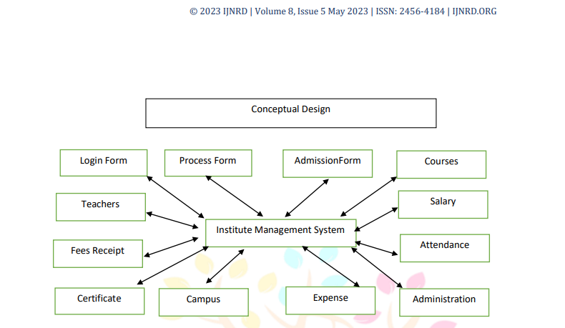
The following diagram focuses on the conceptual design of the Implementation of the created system by the publishers: (BY IJNRD refer to pg. j482)
(Dy patil Institute May 2023 Volume 8 pg. j482 , INJRND.ORG)
SLRTCE- Department of Information Technology
10

Slide 11
The Hardware requirements for the following system is as follows:-
Network: Moderately – highly good internet connection to ensure access and continuous connectivity. (minimum 30 Mbps recommended) can be ethernet , modem or wi-fi.
Device(s): A functional phone/tablet to the above-mentioned network acquired with a minimum of 64 GB external space (browser memory). A functional desktop/laptop to the above-mentioned network acquired with a minimum of 8 GB RAM and 128 HDD OR SSD.A minimum Intel Core i3 or equivalent (for desktops/laptops) for basic functionality. However, an Intel Core i5 or higher is recommended for better performance, especially if the system handles high amounts of data or processing.
Display: For laptops and desktops, a monitor with at least a 13-inch display and a resolution of 1280x720 pixels or higher to ensure clear
visibility of the user interface.
SLRTCE- Department of Information Technology
11

Slide 12
Software requirements for the following system is as follows :-
Operating Systems:- Linux (Ubuntu, CentOS) or Windows Server Client Machines: Windows 10/11, macOS, Linux, Android, iOS , Cloud OS.
Development Tools:- Java Development Kit (JDK): Version 11 or Higher.
Web Server: Internet Browsers to browse and access the website, for example: Google Chrome, Microsoft Edge, etc.
Cloud Storage: For additional storage off of hardware disks or SSDs , etc.
SLRTCE- Department of Information Technology
12

Slide 13
Innovations in Our Solution:-
The innovative aspects of UniSync lie in both its technical foundation and its user-centric approach to modernize university operations. The solution stands out by providing an all-in-one platform that integrates several key functions, including student-faculty communication, fee processing, and complaint management, while being built entirely with Java, a powerful and flexible programming language.
Technical Innovations:
Java-Based Full Stack Solution: Unlike many university management systems that rely on a mix of technologies (such as PHP for front-end and back-end or cloud-based solutions), UniSync is built exclusively in Java. This ensures cross-platform compatibility, heightened security, and a reduced likelihood of security breaches due to the strong object-oriented structure of Java.
Database Integration: The solution leverages robust database connectivity through JDBC (Java Database Connectivity) for secure data management. Student information, fee transactions, and complaints are stored in a MySQL database, ensuring consistency, data integrity, and easy retrieval. The use of prepared statements in Java minimizes the risks of SQL injection, ensuring secure database interaction.
SLRTCE- Department of Information Technology
13

Slide 14
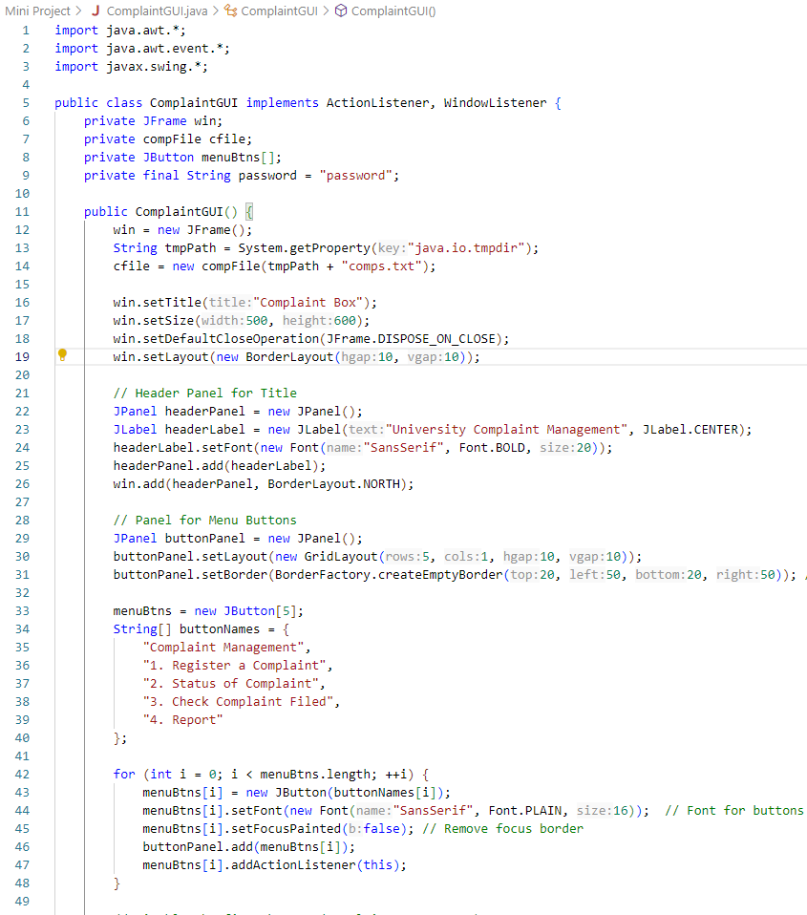
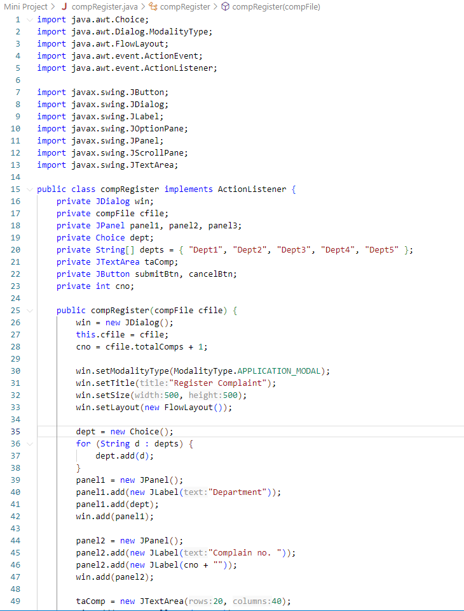
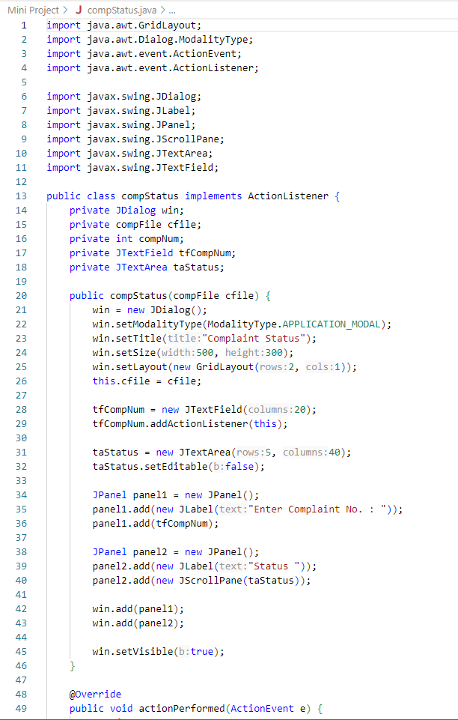
Input:-

Slide 15
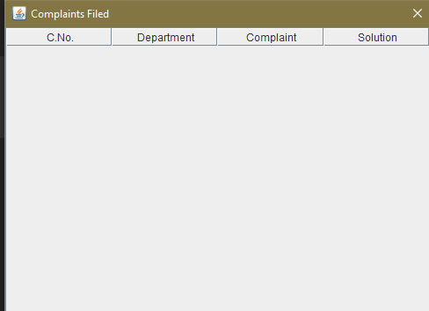
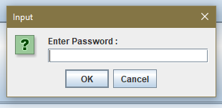
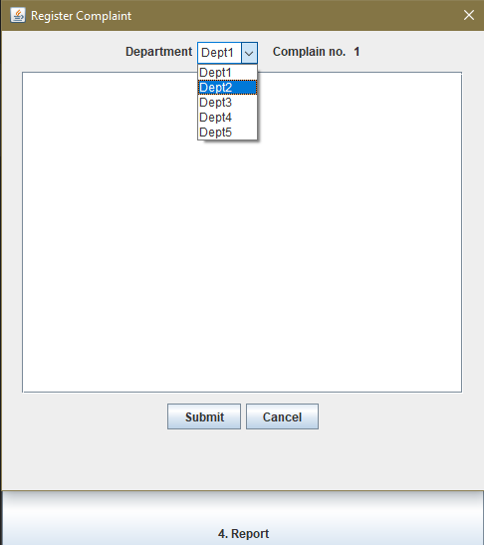
Output:-
(use of passkey/passwords for
security and privacy of filed complaints)
(Complain registry with department info integrated within.)
(Database connectivity i.e. any changes in the form of
Complaints will be stored here and the database simultaneously)

Slide 16
Conclusion:-
In conclusion, UniSync not only offers a solution to current administrative challenges but also positions universities for future growth and adaptability. By leveraging technology to streamline processes, this project paves the way for a more efficient, responsive, and student-centric educational environment. The successful deployment of UniSync will ultimately contribute to the advancement of institutional effectiveness and improve the overall quality of education.
SLRTCE- Department of Information Technology
16

Slide 17
References:-
[1] A. B. Chibuike, B. C. Nwoke, and L. Eleberi, "An online departmental fee management system
," International Journal of Computer Science and Engineering (IJCSE)
, vol. 20, no. 1, pp. 78-80, 2020. Available: https://www.ijcseonline.org/pub_paper/20-IJCSE-07830-1.pdf.
[2] "Design and implementation of online student registration portal," Scribd.
Available: https://www.scribd.com/document/432352134/Design-and-Implementation-of-Online-Student-Registration-Portal.
[3] G.-A. Istrate, R. A. Budu, and C. A. Popa, "Institutional communication in the digital age," ResearchGate, 2022.
Available: https://www.researchgate.net/publication/365279826_Institutional_communication_in_the_digital_age.
[4] "Implementation of online registration portal," International Journal of Emerging Research in Technology,
vol. 13, no. 7, pp. 1-10, 2022. Available:
https://www.ripublication.com/irph/ijert20/ijertv13n7_36.pdf.
SLRTCE- Department of Information Technology
16

Slide 18
THANK YOU- By SSP
SLRTCE- Department of Information Technology
18

